Slide 1
Food image classification
Vivek Agarwal
Manikandan Eswaran
Manish Kumar
Harminder Singh

Slide 2
Introduction
We have a dataset of about 300 images. Our goal is to train our model to classify these images as Entrée, Salad and Dessert.
We have used two approaches to get our results. Unsupervised learning where we do not use the labels that we have and Supervised learning where we use the labels

Slide 3
Sections
Unsupervised Learning
Supervised Learning

Slide 4
Unsupervised Learning
Unsuperivsed learning is used where we do not have the labels for our dataset. The algorithm clusters together similar data points based on the features that we supply to the model.
We have used the K-Means algorithm into to separate the data into three clusters.

Slide 5
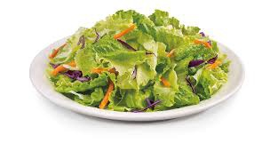
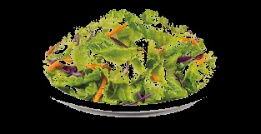
Binary thresholding
Used a preprocessing technique on all the images called binary thresholding in order to eliminate the backgrounds we had in our image and made a new set of images

Slide 6
Steps
Resizing the image
Resized the images to 80 X 80 in order to reduce the number of columns we had in our dataset
Hog descriptor
Used the Hog descriptor to get correct information about the image. This contributed to our data set.
New features
Extracted the colors from every image and made three new columns representing the RED, GREEN, BLUE colors.
Algorithm Applied
Applied the K-means algorithm in order to make three clusters which is an unsupervised learning algorithm

Slide 7
Results
 | Cluster 1 | Cluster 2 | Cluster 3
Salad | 63 | 18 | 19
Entrée | 0 | 71 | 22
Dessert | 1 | 30 | 69

Slide 8
Supervised Algorithm

Slide 9
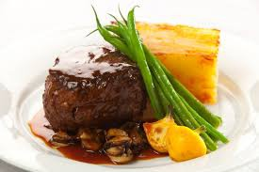
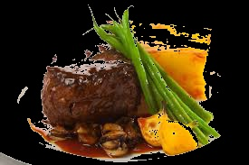
binary thresholding
Used a preprocessing technique on all the images called binary thresholding in order to eliminate the backgrounds we had in our image and made a new set of images.

Slide 10
Steps
Resizing the image
Resized the images to 80 X 80 in order to reduce the number of columns we had in our dataset
Hog descriptor
Used the Hog descriptor to get correct information about the image. This contributed to our data set.
New features
Extracted the colors from every image and made three new columns representing the RED, GREEN, BLUE colors.
Algorithm Applied
Applied the SVM algorithm in order to make three clusters which is an supervised learning algorithm

